Slide 1
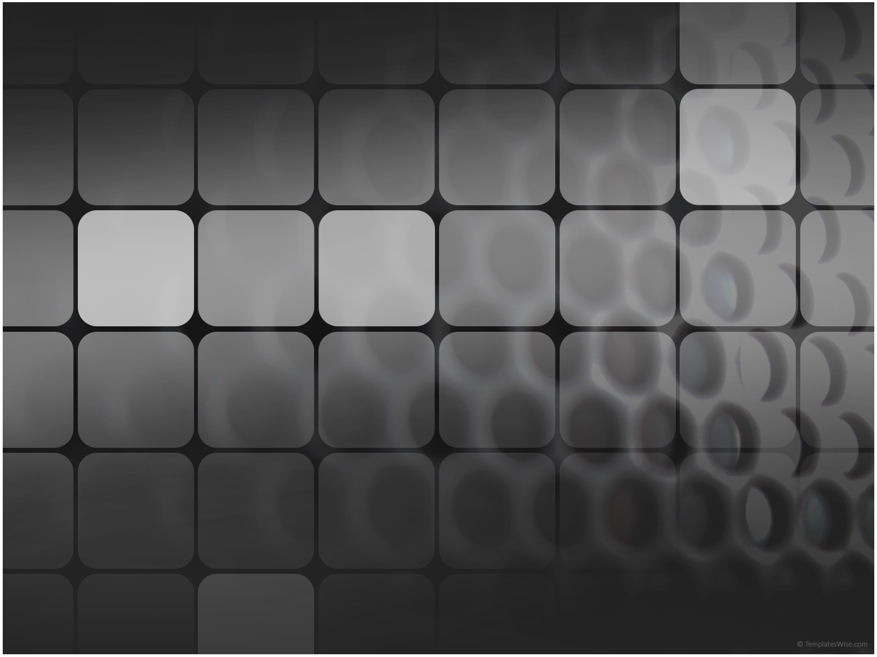
将棋
しょう ぎ
An Intelligent* Shogi Player
Paul Varoutsos
AI Spring 2011
*Relatively

Slide 2
Shogi
将 (General)
棋 (Chess)
Established around 1200
  Present form played as early as 1600
Similar to chess
  Piece upgrades
  Drop rule

Slide 3
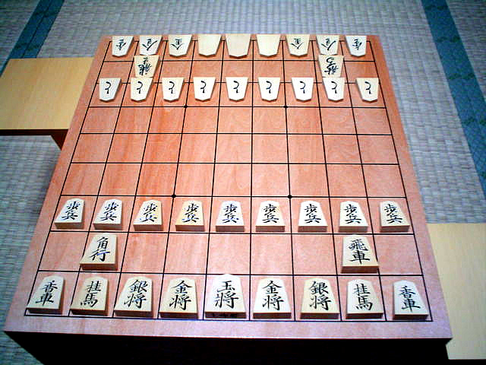

Shogi

Slide 4















Pieces
1 King 王 (King)
1 “Rook” 飛 (Fly/Soar)
1 “Bishop” 角 (Angle)
2 Gold Generals 金 (Gold)
2 Silver Generals 銀 (Silver)
2 Knights 桂 (Japanese Tree)
2 Lances 香 (Incense/Smell)
9 “Pawns” 歩 (Walk)

Slide 5
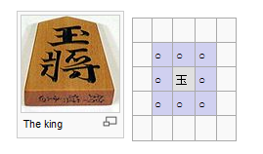
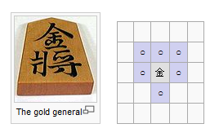
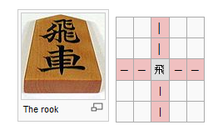
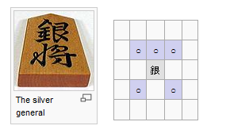
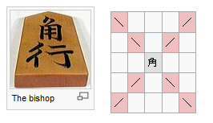
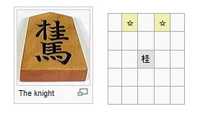
Legal Moves

Slide 6
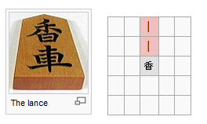
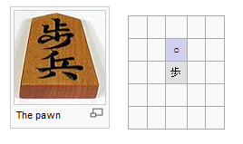
Legal Moves
When promoted:
  Silver general, knight, lance, and pawn move like a gold general.
  Rook and bishop keep original power of movement but may also move like a king.
  King and gold general cannot promote.

Slide 7
Rules
Game ends when opponents King is captured.
Pieces may be dropped anywhere.
  Exception: You may not drop a pawn in a column with another pawn.
You may choose to promote a piece when it lands in the opponents third of the board.

Slide 8
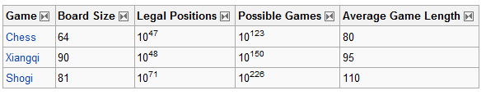
Shogi AI
Shogi’s branching factor is greater than all Chess variants.
Chess’ branching factor: ~35
Shogi’s branching factor: ~80
In 2008 the first Shogi AI beat a competetive Shogi player (without a Handicap)

Slide 9
AI Approach
Minimax
Alpha-Beta Pruning
  Small improvement
Evaluation Function
  Relative weights
  Reservoir Pieces
  Board Pieces
  Mobility

Slide 10
Relative Weight
Piece | Chess | Shogi
Pawn | 1 | 1
Bishop | 3 | 3.3
Knight (Chess) | 3 | -
Knight (Shogi) | - | 3
Rook | 5 | 5
Lance | - | 1.3
Silver General | - | 4
Gold General | - | 3
Queen | 9 | -
King | ∞ | ∞

Slide 11
Evaluation Function
Evaluation function
Where material weight + mobility weight = 1.0
Material Weight
  Looks at captured pieces in reservoirs
  Looks at pieces on the board

Slide 12
Evaluation Function
Mobility weight
  Looks at how mobile pieces are
  Looks at what pieces are being attacked/defended

Slide 13
Future Improvements
Further analysis on relative weights
Possible additions to evaluation function
Minimax improvements
  Reduce the search space
Incorporate opening move sequences
End game database

Slide 14
Search Pathology
Deeper Minimax Search results in worse play….
Possible Reasons
  My evaluation function/relative weight
  Shogi may be a gametype susceptible to Game Search Pathology
  Minimax expects me to make good moves
  Biasing
    Last player theorem
    Eval Function

Slide 15
Sources
"Shogi." Wikipedia. Wikimedia Foundation, 3 Apr. 2011. Web.
8 Apr. 2011. <http://en.wikipedia.org/wiki/Shogi>.
Davis, Gene. "Shogi: Samurai Chess." Gene Davis Software.
Gene Davis Software. Web. 8 Apr. 2011.
<http://www.genedavissoftware.com/games/>.

Slide 16
Shogi AI Demo

